Slide 1
MESH2IR: Neural Acoustic Impulse Response Generator for Complex 3D Scenes
Anton Ratnarajah, Zhenyu Tang, Rohith Aralikatti, Dinesh Manocha

Slide 2

MESH2IR
We propose a mesh-based neural network (MESH2IR) to predict acoustic impulse response (IR) for a given 3D indoor scene.
Our MESH2IR can generate more than 10,000 IRs per second on an NVIDIA GeForce RTX 2080 Ti GPU.
IRs generated from our MESH2IR shows significant improvement in performance in speech processing applications.

Slide 3
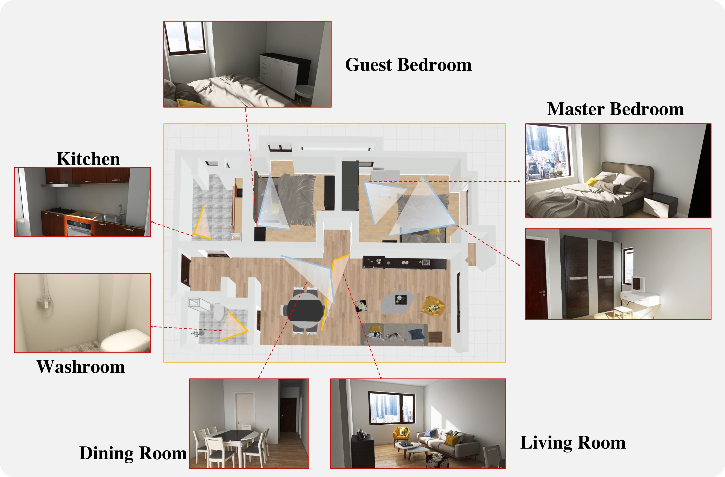
3D Indoor Scene
3D-Front Dataset
Huan Fu, Bowen Cai, Lin Gao, Ling-Xiao Zhang, Jiaming Wang, Cao Li, Qixun Zeng, Chengyue Sun, Rongfei Jia, Binqiang Zhao, et al. 2021. 3d-front: 3d furnished rooms with layouts and semantics. In Proceedings of the IEEE/CVF International Conference on Computer Vision. 10933–10942.

Slide 4
GWA Dataset
GWA dataset consists of 2 million acoustic impulse responses (IRs) simulated on 3D-Front Dataset.
The IRs are simulated using hybrid method to create high quality low-frequency and high-frequency wave effects.
Zhenyu Tang, Rohith Aralikatti, Anton Ratnarajah, and Dinesh Manocha. 2022. GWA: A Large High-Quality Acoustic Dataset for Audio Processing. ArXiv abs/2204.01787 (2022).

Slide 5
IR Representation
We downsample the IRs in the GWA dataset to 16 kHZ and crop the IRs to have a duration of 0.25 seconds.
We preprocess the IRs to have a same standard deviation (STD) of 0.1.
To recover the IR with the original magnitude, we duplicate the standard deviation of the IRs 128 times and concatenate them at the end of the preprocessed IRs.
(IR / (10 * STD of IR))
STD
3968 samples
128 samples

Slide 6
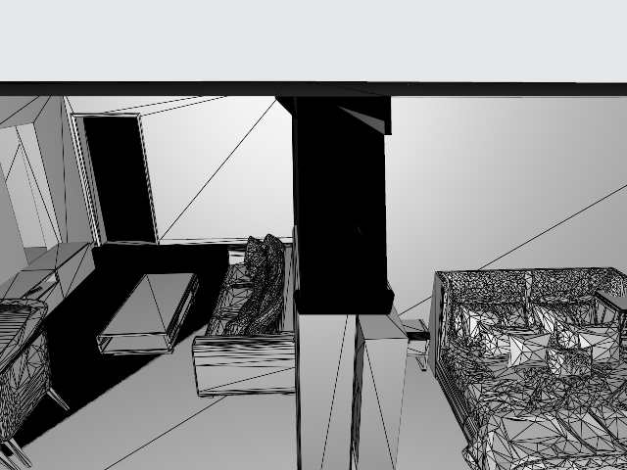
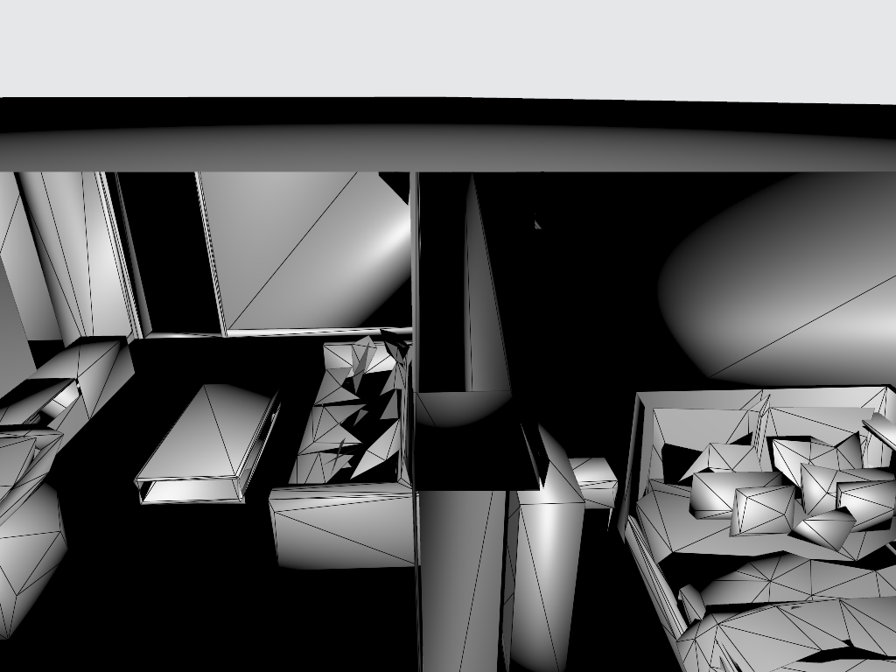
Mesh Simplification
Before
After

Slide 7
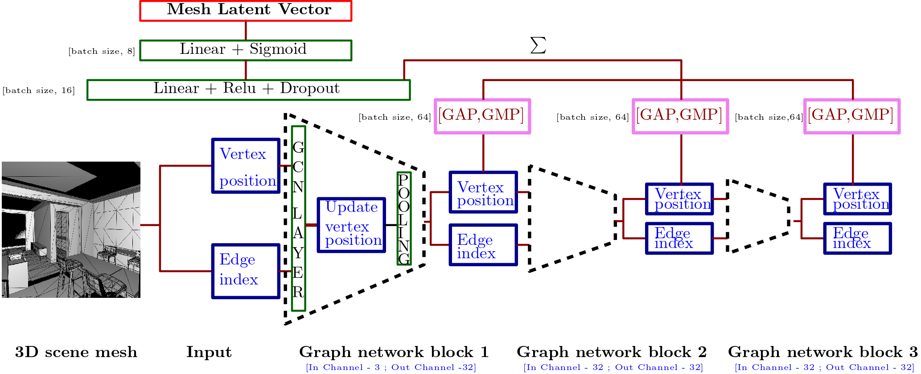
Mesh Encoding

Slide 8
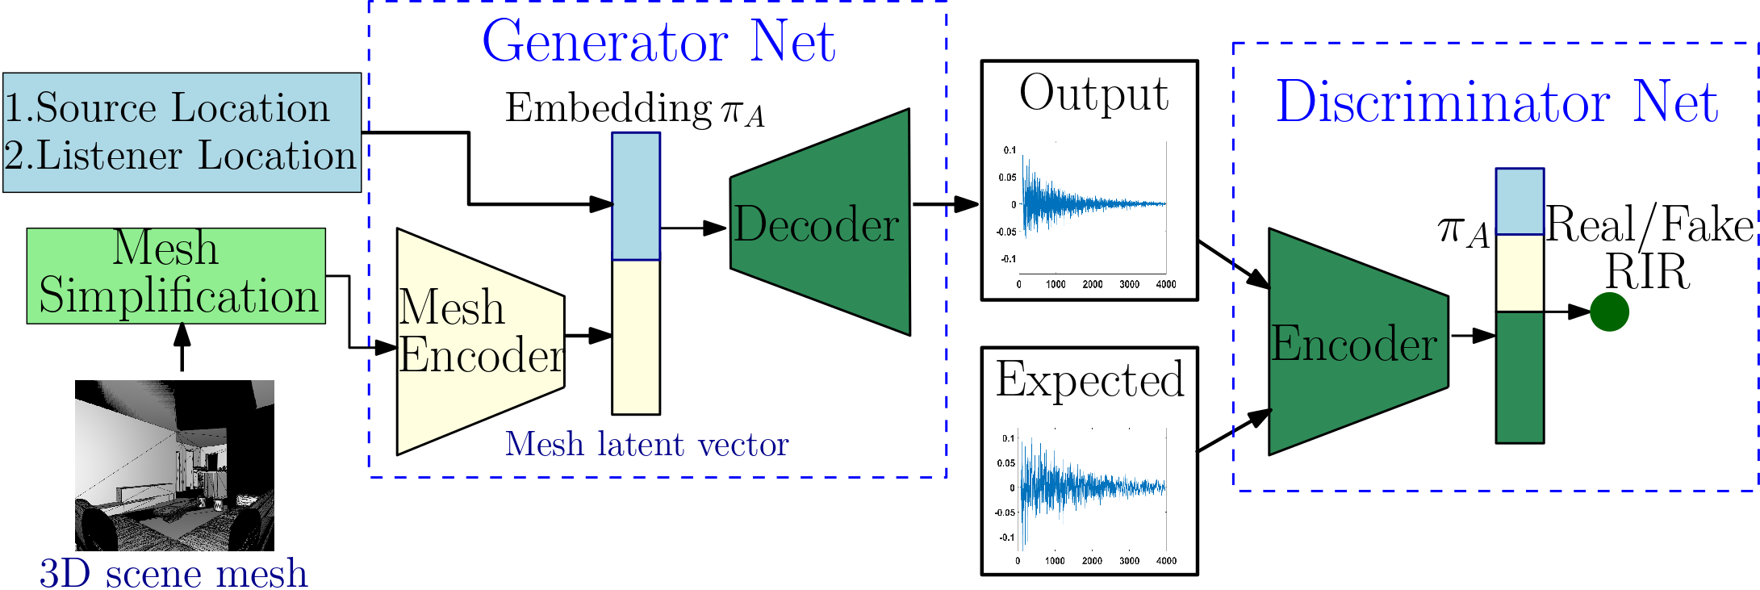
Full Architecture

Slide 9
Neural Sound Rendering
We demonstrate the sound rendering quality of our MESH2IR on 3 different 3D indoor scenes.

Slide 10
Neural Sound Rendering
Scenario 1: A person sings inside a bedroom and the listener moves around the house. The sound source (i.e., song) is represented using a red sphere.

Slide 11
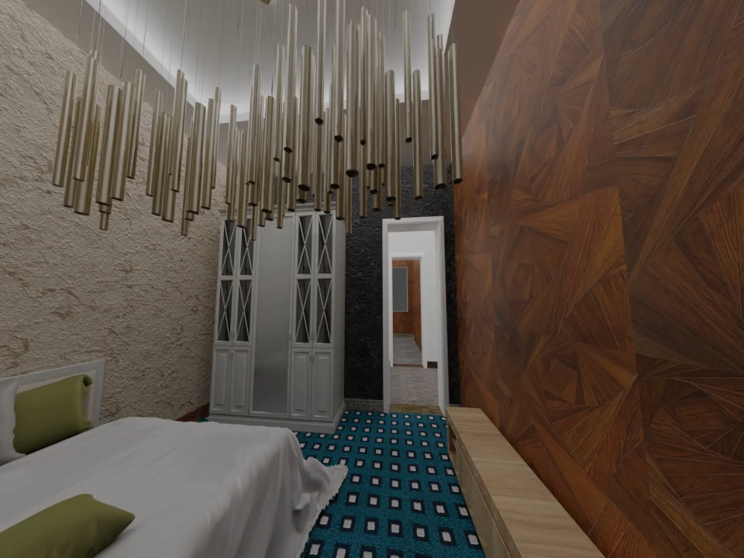
Neural Sound Rendering

Slide 12
Neural Sound Rendering
Scenario 2: In this example, the phone rings in the bedroom and we play the piano in the living room. We move the listener around the house. The sound sources (i.e., ring and piano) are represented using a red sphere.

Slide 13
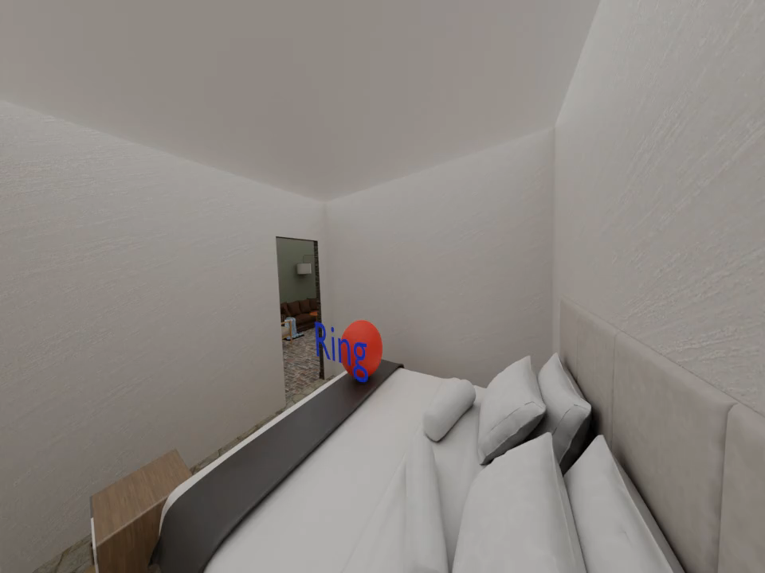
Neural Sound Rendering

Slide 14
Neural Sound Rendering
Scenario 3: In this example, a person speaks in the hall and a machine works inside a room. We move the listener around the house. The sound sources (i.e., speech and machine) are represented using a red sphere.

Slide 15
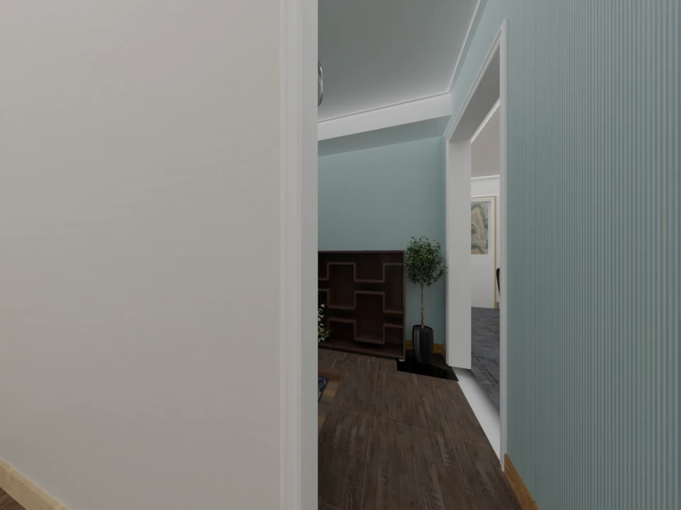
Neural Sound Rendering

Slide 16
Runtime
Table 1: The average runtime of generating 30,000 IRs using our MESH2IR
Stages | Hardware | Average Time
Mesh Simplification | CPU | 7.5 s
Mesh-to-graph conversion | CPU | 0.04 s
MESH2IR [Mesh Encoder] (Batch Size 128) | GPU | 2.57 x 10⁻³ s
MESH2IR [IR Generator] (Batch Size 128) | GPU | 7.4 x 10⁻⁵ s
Performed only once for a given furnished indoor 3D scene.
Our MESH2IR can generate more than 10,000 IRs per second on a single GPU for a given furnished indoor 3D scene.

Slide 17
Speech Application
We demonstrate the benefit of our MESH2IR for speech applications – speech dereverberation, and reverberant speech separation.
We generated 11,000 IRs from 600 scene meshes not used during training our MESH2IR using GA [1], GWA[2], and MESH2IR.
We generated reverberant speech using the 11,000 IRs, and train speech dereverberation and speech separation methods.
Reverberant Speech = Clean Speech ∗ IR
[1] Zhenyu Tang, Lianwu Chen, Bo Wu, Dong Yu, and Dinesh Manocha. 2020. Improving Reverberant Speech Training Using Diffuse Acoustic Simulation. In ICASSP. IEEE, 6969–6973
[2] Zhenyu Tang, Rohith Aralikatti, Anton Ratnarajah, and Dinesh Manocha. 2022. GWA: A Large High-Quality Acoustic Dataset for Audio Processing. ArXiv abs/2204.01787 (2022).

Slide 18
Speech Dereverberation
Speech dereverberation is the process of obtaining reverb-free speech from reverberant speech.
Model | SkipConvNet [1] with default parameters.
Clean Speech | WSJ Corpus [2]
Training Synthetic IRs | GA, GWA, MESH2IR
Test Recorded IRs | MIT IR dataset [3], the BUTReverb dataset [4], RWCP Aachen IR dataset [5]
Metrics | Speech-to-reverberation modulation energy ratio (SRMR)
[1] Vinay Kothapally et al., “ Skipconvnet: Skip convolutional neural network for speech dereverberation using optimally smoothed spectral mapping”. INTERSPEECH 2020.
[2] Robinson et al., “WSJ-CAMO: a British English speech corpus for large vocabulary continuous speech recognition,” ICASSP, 1995
[3] James Traer et al., “Statistics of natural reverberation enable perceptual separation of sound and space”. Proceedings of the National Academy of Sciences 2016
[4] Igor Szöke et al., “Building and evaluation of a real room impulse response dataset.” IEEE Journal of Selected Topics in Signal Processing 2019.
[5] Marco Jeub et al., “A binaural room impulse response database for the evaluation of dereverberation algorithms.” 16th International Conference on Digital Signal Processing 2009

Slide 19
Speech Dereverberation
Table 2: Speech dereverberation results are obtained when training data is generated by different synthetic IR generation methods. Testing is done on reverberant data synthesized from IRs present in three different datasets containing recorded IRs collected in a variety of environments. Higher
SRMR is better.
Training Dataset | SRMR
 | MIT | BUTReverb | RWCP Aachen
GA [1] | 6.39 | 3.74 | 4.83
GWA [2] | 7.67 | 4.6 | 6.14
MESH2IR (ours) | 7.82 | 4.27 | 5.88
[1] Zhenyu Tang, Lianwu Chen, Bo Wu, Dong Yu, and Dinesh Manocha. 2020. Improving Reverberant Speech Training Using Diffuse Acoustic Simulation. In ICASSP. IEEE, 6969–6973
[2] Zhenyu Tang, Rohith Aralikatti, Anton Ratnarajah, and Dinesh Manocha. 2022. GWA: A Large High-Quality Acoustic Dataset for Audio Processing. ArXiv abs/2204.01787 (2022).

Slide 20
Speech Seperation
Speech separation is the process of separating a mixture of speech signals into its constituent speech signals.
Model | DPRNN-TasNet [1]
Clean Speech | Libri2Mix [2]
Training Synthetic IRs | GA, GWA, MESH2IR
Test Reverberant Speech | VOiCES dataset [3]
Metrics | Scale-Invariant Signal Distortion Ratio (SI-SDRi)
[1] Yi Luo et al., “Dual-path rnn: efficient long sequence modeling for time-domain single-channel speech separation.” ICASSP 2020.
[2] Joris Cosentino et al., “Librimix: An open-source dataset for generalizable speech separation.“ arXiv 2020.
[3] Colleen Richey et al., “Voices obscured in complex environmental settings (voices) corpus”. arXiv 2018.

Slide 21
Speech Seperation
Table 3: Speech separation results in the presence of reverberation are shown below. We report the improvement in the Scale-Invariant Signal Distortion Ratio (SI-SDRi) over the reverberant mixture. Higher Si-SDRi is better. We report performance on reverberant mixtures generated in four different room configurations present in the VOiCES dataset.
Training Dataset | SI-SDRi
 | Room 1 | Room 2 | Room 3 | Room 4
GA [1] | 2.26 | 2.22 | 1.33 | 2.35
GWA [2] | 4.75 | 4.75 | 2.41 | 4.91
MESH2IR (Ours) | 4.91 | 4.89 | 2.54 | 5.13
[1] Zhenyu Tang, Lianwu Chen, Bo Wu, Dong Yu, and Dinesh Manocha. 2020. Improving Reverberant Speech Training Using Diffuse Acoustic Simulation. In ICASSP. IEEE, 6969–6973
[2] Zhenyu Tang, Rohith Aralikatti, Anton Ratnarajah, and Dinesh Manocha. 2022. GWA: A Large High-Quality Acoustic Dataset for Audio Processing. ArXiv abs/2204.01787 (2022).

Slide 22
Conclusion
We present a novel neural-network-based MESH2IR architecture to generate thousands of IRs for a given furnished indoor 3D scene on the fly.
We show that the IRs predicted by our MESH2IR in unseen indoor 3D scenes are highly similar to the ground truth IRs generated from the GWA dataset, which is used to train our MESH2IR.

